Slide 1
Indoor locating and tracking
Kun Wang
Wenhao Wu
Notes:
Hi, everyone! The topic of our project is indoor locating and tracking. my name is Kun Wang and my partner’s name is Wenhao Wu.

Slide 2
Outline
1. Background
2. RADAR
1) NNSS/NNSS-AVG
2) Viterbi-like Algorithm
3. HMM-based Algorithm
1) Modeling
2) Simulation
Notes:
This is the outline of our presentation.

Slide 3
Outline
1. Background
2. RADAR
1) NNSS/NNSS-AVG
2) Viterbi-like Algorithm
3. HMM-based Algorithm
1) Modeling
2) Simulation
Notes:
First, let me introduce the background knowledge.

Slide 4
Background
IR-based systems
1. high installation and maintenance cost
2. poor performance in the presence of sunlight
RF-based systems
Cellular-based systems
1. multiple reflections in indoor environment
2. inability of off-the-shelf and inexpensive hardware
Other systems: ultrasound, magnetic field, etc.
Notes:
Generally speaking, locating and tracking systems can be classified into 4 categories: the first is IR-based. However, it has high installation and maintenance cost and it performs poorly when there is direct sunlight. The second is RF-based. Our simulations are based on this type, so I will talk about it later. The third one is cellular-based; it measures metrics such as signal attenuation, time of arrival and so on. however, it is promising in outdoor environments, because of the multiple reflections in indoor environment, and also it is expensive to implement. Other systems include ultrasound, magnetic field, etc. but they are rarely used.

Slide 5
Outline
1. Background
2. RADAR
1) NNSS/NNSS-AVG
2) Viterbi-like Algorithm
3. HMM-based Algorithm
1) Modeling
2) Simulation
Notes:
Now, we move on to the RADAR Algorithm.

Slide 6
RADAR
Advantages
implemented purely in software.
easily deployable over a standard WLAN.
Fundamental idea
received signal strength in an RF network is a function of the receiver’s location.
Notes:
The RADAR algorithm is RF-based. There are two main advantages: first it is implemented purely in software and it is easily deployable over a standard WLAN.
The fundamental idea behind this algorithm is quite straightforward: the received signal is strongest when the receiver is close to the AP and weakest when it is far away, so the received signal strength is a function of the receiver’s location.
It can be verified by the radio map on the next slide.

Slide 7
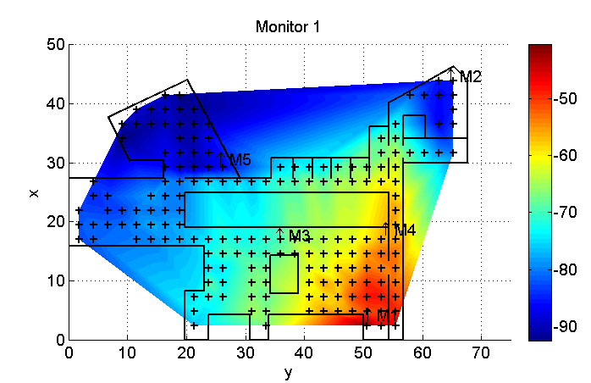
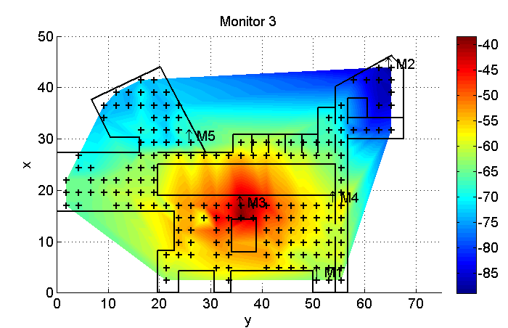
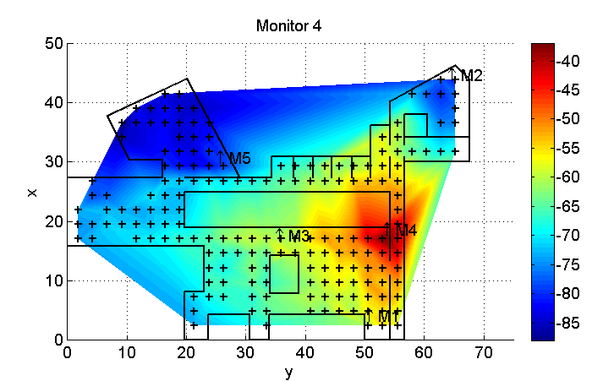
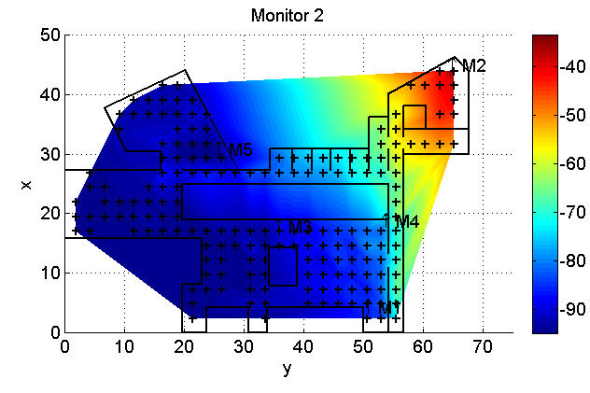
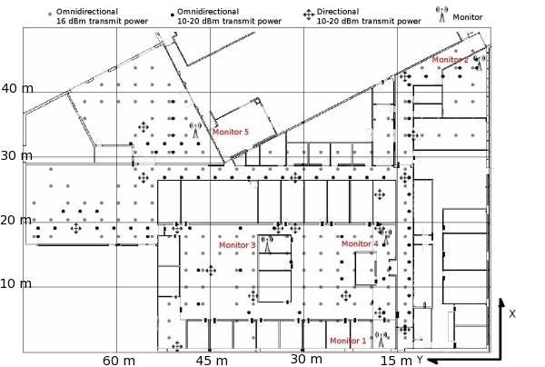
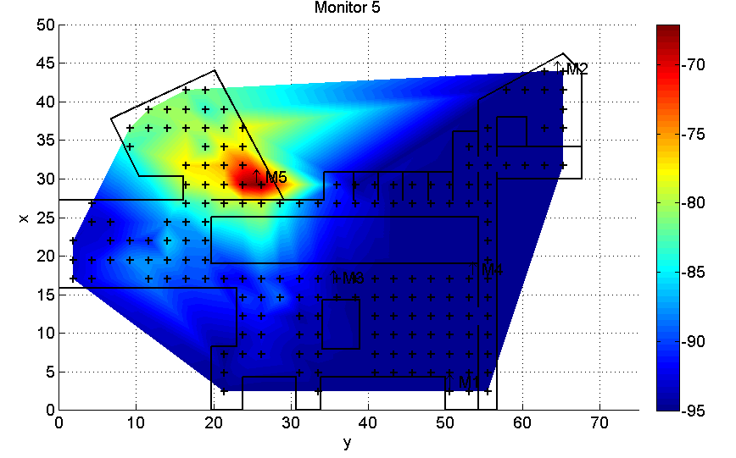
Notes:
This is the floor plan. those dots are where the signal strength is measured and there are five monitors on this map.
Then we can see the signal strength level of the five monitors, which verify the fundamental idea of this algorithm.

Slide 8
RADAR
Implementation
1. Offline phase
Radio Map – database of locations in the building and the received signal strength from the APs at these locations
A typical entry – (x, y, d, ss₁, ss₂, ss₃, ss₄, ss₅)
2. Online phase
Basic algorithm: nearest neighbor in signal space (NNSS)
Euclidean distance between {ss_{i}} and {ss’_{i}} for i from 1 to 5
Variant: NNSS-AVG.
Notes:
Now, let me talk about the implementation issues. The implementation involves two steps: the first is offline phase, we use measurement devices to get the radio map.
The radio map is essentially a database of locations in the building and the received signal strength from the APs at these locations. A typical entry looks like. x y are the coordinates on the floor. d is the direction the person is facing towards. ss1 to ss5 are received signal strength from the five APs.
The second phase is to locate the position of mobile user in real time. The basic algorithm is call nearest neighbor in signal space (NNSS).
It computes the Euclidean distance between the measured SS tuple and the SS tuple in database. Then it picks the tuple that minimizes the distance. It declares position corresponding to this tuple to be the estimated position.
A variant is NNSS-AVG. Because there are often more than one SS tuple that are close to the measured SS tuple, so there is little reason that we just pick one and discard all others. So the NNSS-AVG algorithm picks a small number of closely matched tuples and take average of their physical locations.

Slide 9
RADAR: Viterbi-like Algorithm
Static locating: NNSS and NNSS-AVG
Tracking: Viterbi-like Algorithm
Intuition:
A mobile user cannot “jump” over a large distance in a short time (i.e. between two measuring instants).
Basic principle:
Consider location information from the past
Complement signal strength information with physical contiguity constraint.
Notes:
However, NNSS and NNSS-AVG are mainly for static locating. When used for tracking, their performance is not good because they don’t consider information from the past.
When tracking the user, we use a Viterbi-like Algorithm. The intuition is that a mobile user cannot “jump” over a large distance in a short time. That is to say, it imposes physical contiguity constraint on the mobile user.

Slide 10
RADAR: Viterbi-like Algorithm
k nearest neighbors in signal space.
h is the history depth.
transition likelihood is measured by the Euclidean distance between two physical locations – as the weight.
the larger the weight is, the less likely is the transition.
demo
Notes:
Now let me explain how the Viterbi-like Algorithm works. Each time a signal strength tuple is obtained by the mobile user, we then use the NNSS to determine the k nearest neighbors in signal space. A history of depth h of such information is maintained. We can see it in this figure. Each edge is assigned a weight to model the likelihood of the user transitioning. We use a very simple metric  the Euclidean distance between the two physical locations  as the weight. The larger the weight is, the less likely is the transition. It also implies that there is a lag of h samples between the user’s real location and the guess. If the sample is fast enough, we can neglect this effect.

Slide 11
Outline
1. Background
2. RADAR
1) NNSS/NNSS-AVG
2) Viterbi-like Algorithm
3. HMM-based Algorithm
1) Modeling
2) Simulation

Slide 12
HMM-based Algorithm
Shortcomings of the RADAR algorithm
Doesn’t consider walking speed variance
Doesn’t make use of the floor plan information
HMM-based algorithm
Make use of the user’s walk speed information
Can be acquired from the inertial sensor embedded on mobile devices
Take advantage of the fact that the user cannot walk through walls
Notes:
The shortcomings of the basic RADAR algorithm is that it doesn’t consider the walking speed variance and it doesn’t make use of the floor plan information. Therefore we proposed a Hidden Markov Model based localization and tracking algorithm. In this algorithm, we make use of the walking speed information, which can be acquired from the inertial sensors embedded on modern mobile devices. We also take advantage of the fact that the user cannot walk through walls.

Slide 13
HMM-based Algorithm: Modeling
Modeling RSSI
Gaussian distribution
Modeling user’s walking pattern
Non-stationary Hidden Markov Process
Notes:
We model the received signal strength index as Gaussian distributed. M_i and K_i are the RSSI mean and covariance at measurement position i respectively.
Then we model the users walking pattern as a non-stationary Hiddden Markov process. The transition probability from position i to position j is proportional to this equation, which is determined by the walking distance between position i and j and the walking speed. If that distance matches the user’s speed pretty well, then the transition probability is large and vice versa.

Slide 14
Notes:
This is what the transition probability looks like. Suppose there is no wall on the plane. When the speed is 0, it is highly likely that the user will stay he is. When the speed is 1 meter per second, it is likely that the user will walk to somewhere 2 meters away from where he is in 2 seconds. And when the speed is 2 meter per second, it is pretty much the same thing.

Slide 15
HMM-based Algorithm: Modeling
k nearest neighbors in signal space.
Reduce the computation complexity of the Viterbi-like algorithm
Transition likelihood depends on
Walk distance between 2 positions
Walking speed
Likelihood
Notes:
One of the classical way to solve this hidden Markov model is the Viterbi algorithm. However, the computation complexity is proportional to the square of the number of measurement positions on the floor plan. In order to reduce the complexity, similar to the RADAR algorithm, we find the k nearest measurement positions by comparing the observed RSSI with the mean RSSI at each position, and then use the Viterbi algorithm to solve this reduced problem. Now the transition likelihood depends on blahblahblah.

Slide 16
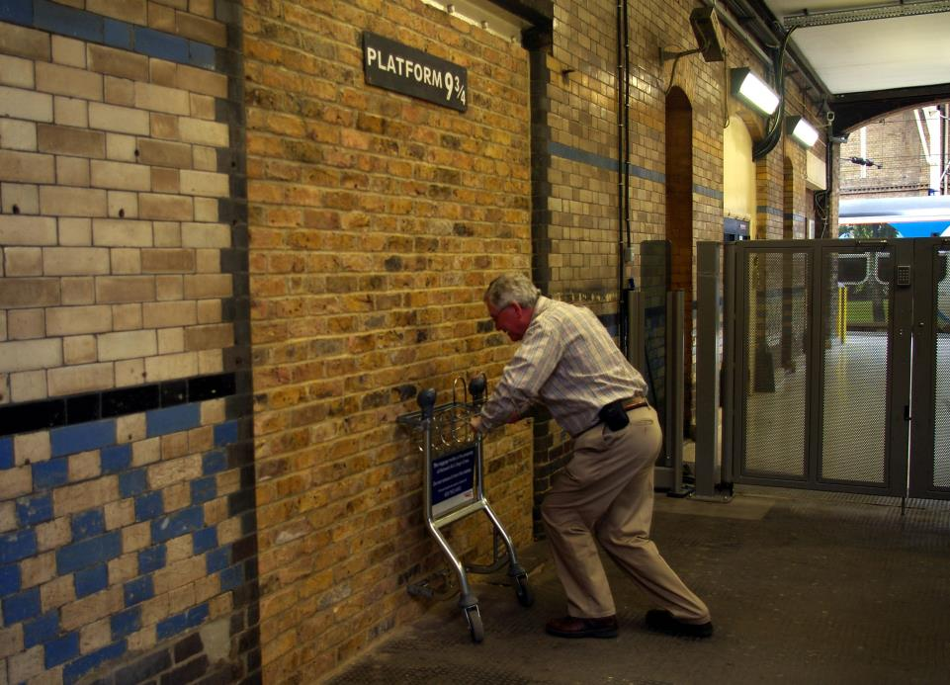
HMM-based Algorithm: Simulation
Simulation settings
Generating user’s path
Variable speed
Don’t cross any wall!
Generating RSSI data along the path
For each location along the path, find 4 nearest measurement positions.
For each measurement position, randomly select a RSSI from ~2000 measurements
Weighted average
Notes:
Now we come to the simulation part. In order to simulate our algorithm based on the dataset, firstly we need to generate a path on the floor plane. In our simulation the user can walk at variable speed along this path. And one reasonable constraint is that the user cannot cross any wall.
Secondly, we need to generate RSSI along this path. For each location along the path, we find 4 nearest measurement positions. Then for each measurement position, we randomly select a RSSI vector from around 2000 measurements in the dataset. Then we generate the RSSI as the weighted average of the 4 selected RSSI vectors. The weighting factor is inverse proportional to their walk distance from the location on the path.

Slide 17
Notes:
Here is the simulation result. The red line is the actual path and the blue line is the real-time estimated path. We can see that the estimation is pretty accurate, especially in the corridor areas. We also have a GUI to demonstrate this localization and tracking algorithm in real time.

Slide 18
HMM-based Algorithm: Simulation
Why localization performance inside a single room not as good as between different rooms?
Spectral Graph Partitioning (SGP)
Notes:
As we can see, the localization and tracking performance is pretty good when the user is walking between different rooms but no as good when the user is walking inside a room. Why is that? Essentially this is because the RSSI characteristics are very alike for measurement positions in a same room but different for measurement positions in different rooms. We demonstrate this with spectral graph partitioning technique.
We define how “close” the measurement position i and position j are similar to each other by w_ij. The first term depends on RSSI proximity and the second term depends on the spatial proximity. So when two measurement positions have similar mean RSSI and are close to each other, this value will be large and vice versa.

Slide 19
Notes:
Now we show the result of the SGP algorithm, we can see that all the measurement positions are clustered into 6 groups. Each group well corresponds to a room on the floor plan. This verifies our argument that the RSSI characteristic are similar within a single room and rather different between different rooms.

Slide 20
THANK YOU!
Notes:
Thank you!

